Slide 1
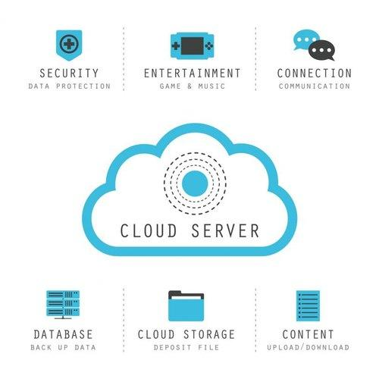
CLOUD CONCEPTS
By:
Ankitha
Bhavika
Pratilipi
Yashaswini

Slide 2
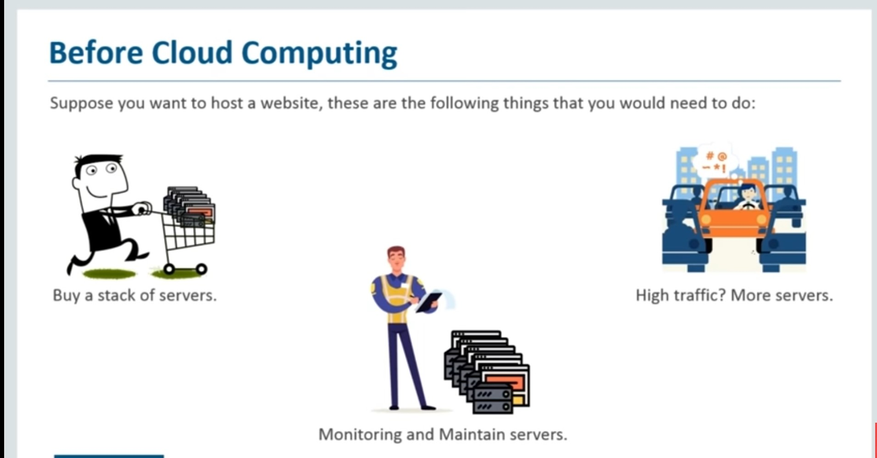
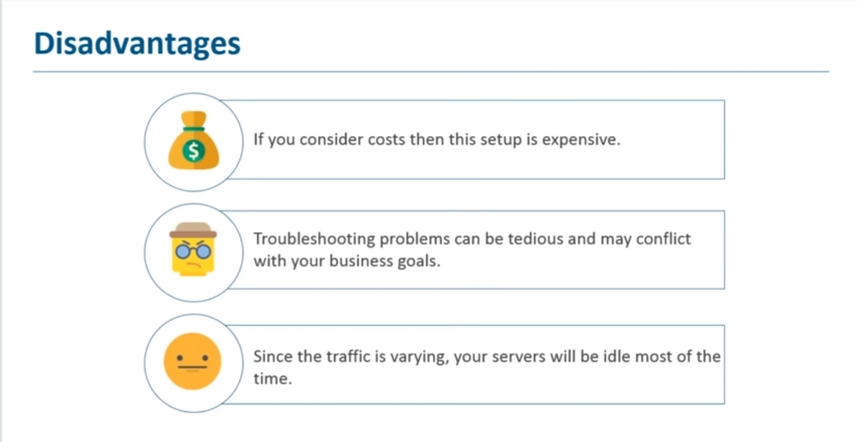
WHY CLOUD?

Slide 3
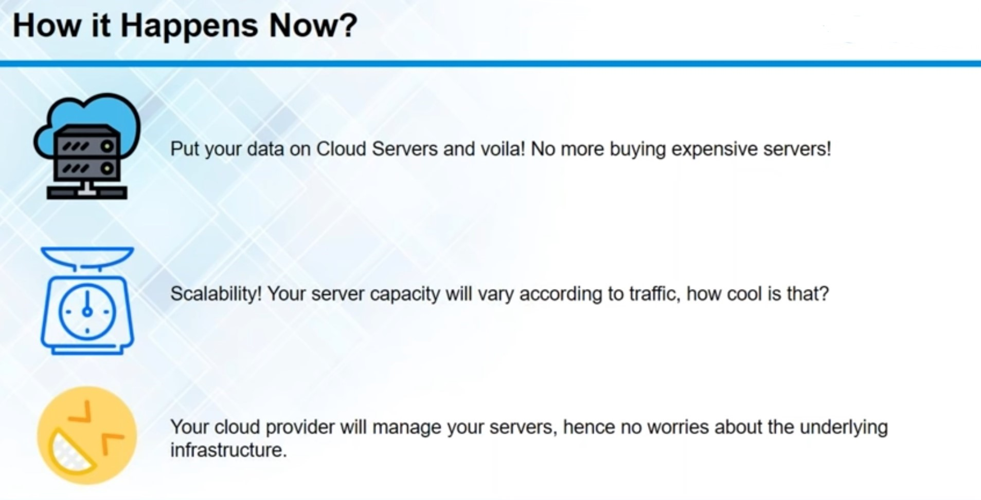

Slide 4
WHAT IS A CLOUD?
"The cloud" refers to servers that are accessed over the Internet, and the software and databases that run on those servers. Cloud servers are located in data centers all over the world. By using cloud computing, users and companies don't have to manage physical servers themselves or run software applications on their own machines
Cloud computing is the delivery of on-demand computing services -- from applications to storage and processing power -- typically over the internet and on a pay-as-you-go basis.
Anything you’ve uploaded to the cloud, or that you run from the cloud, exists on data centers ie there are dedicated servers and storage volumes housed in vast warehouses.

Slide 5
Advantages of Cloud Computing
Cost efficiency
High speed
Excellent accessibility
Back-up and restore data
Manageability
Disadvantages of Cloud Computing
Vulnerability to attacks
Network connectivity dependency
Downtime
Vendor lock-in

Slide 6
Types of Cloud Computing:
Based on deployment models:
Public cloud
Private cloud
Hybrid cloud
Community cloud
Based on service offered:
IaaS
PaaS
SaaS

Slide 7
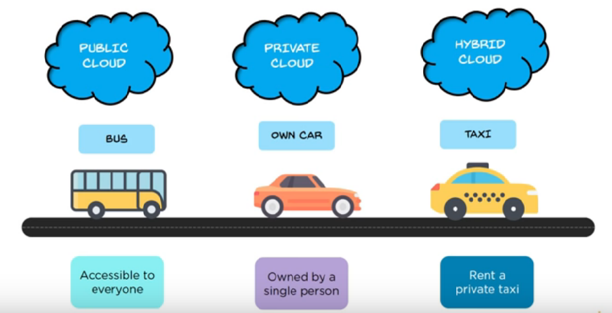

Slide 8
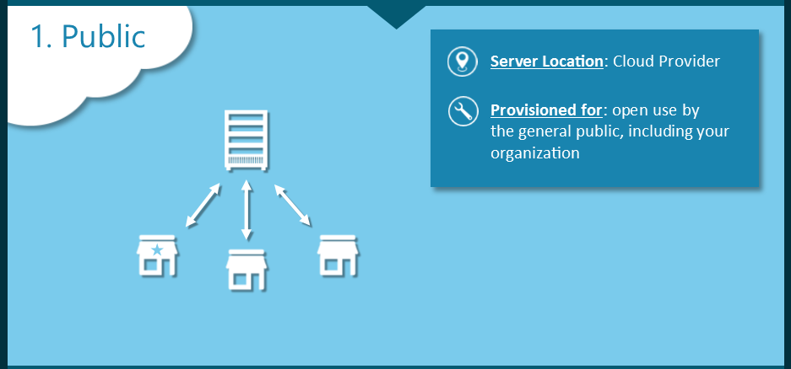
Public Cloud:
Resources are available to the general public over the internet.
Services are stored off-site.
Owned and managed by the cloud provider.
The tenant “rents” a portion on a pay as you go basis
Can scale it as and when required.
Multiple customers share the resources.
Example: Amazon’s Elastic Compute, Google’s AppEngine, IBM’s Blue cloud, Microsoft Azure, etc.

Slide 9
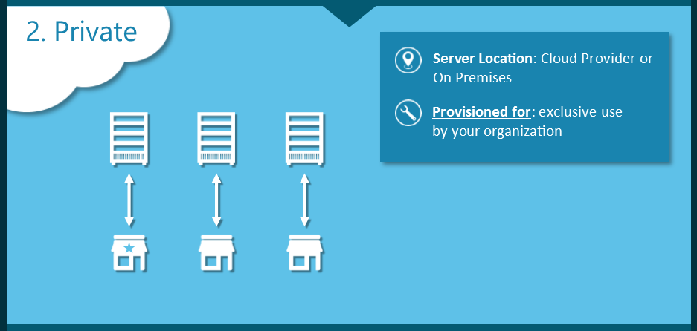
Private Cloud:
Exclusively operated for a single organisation.
Hosted on premise or off-site.
Managed by the organisation or the third party (or both).
Enables a company to take advantage of cloud efficiencies while providing greater control over resources, data security and avoid sharing.
Service Providers: AWS, VMware, Apache, etc provide private cloud services.

Slide 10
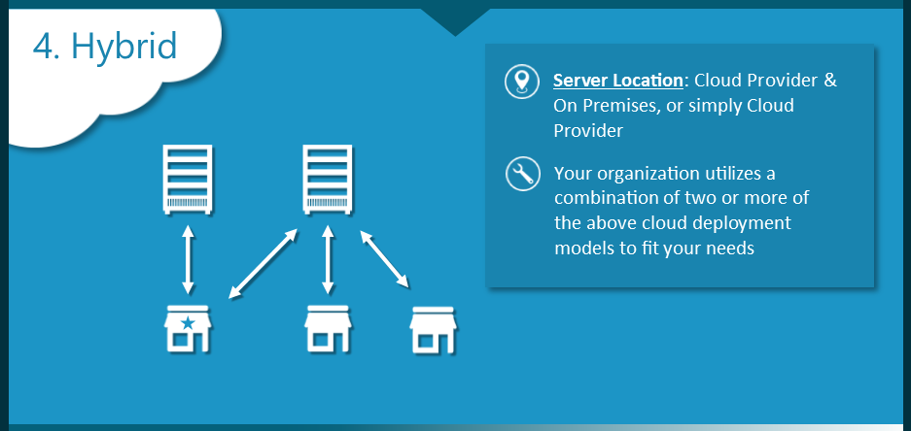
Hybrid Cloud:
Integrates private and public clouds.
As an example, a company can balance its load by locating mission-critical workload on a secure private cloud and deploying less sensitive ones to a public one.
Interact through an encrypted connection which allows apps and information to flow between the two.
Service Providers: Amazon, Google, Microsoft, Cisco, etc.
Example: Finance, Law, Healthcare and Retail.

Slide 11
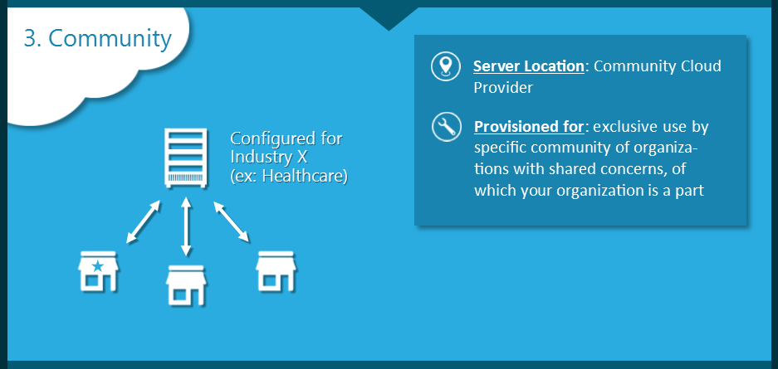
Community Cloud:
Suited for organizations that work on joint projects with similar security, privacy and performance requirements.
Costs are shared across all users.
Managed internally or by a third-party provider.
Hosted externally or intеrnаllу.
Service Providers: Google, IBM, Microsoft, RedHat, etc.
Example:
Virginia Community College System
UnitedHealth Group now provides the Optum Cloud
New York Stock Exchange’s Capital Markets Community Platform

Slide 12
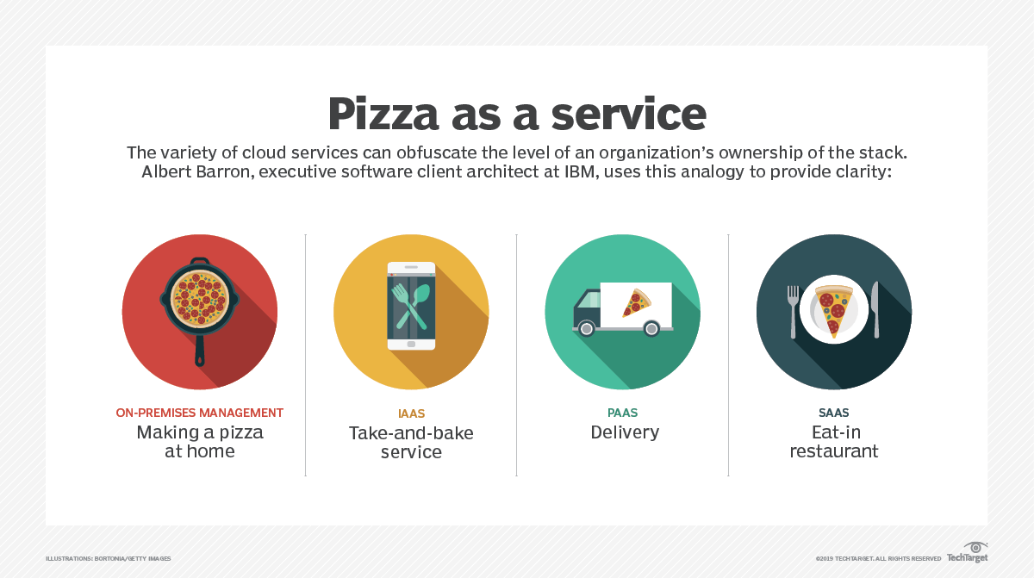
Pizza as a Service:

Slide 13
IaaS (Infrastructure as a Service):
Provides basic computing infrastructure and resources over the internet.
Pay for what you use basis.
Quickly scales up and down with demand.
Service provider manages the infrastructure, while you purchase, install, configure, and manage your own software.
Example providers: Amazon EC2, GoGrid and RackSpace.com
Users: System Administrators

Slide 14
PaaS (Platform as a Service):
A complete development and deployment environment in the cloud
Includes infrastructure—servers, storage and networking—along with middleware, development tools, database management systems and more.
Designed to support the complete web application lifecycle: building, testing, deploying, managing and updating.
Examples: AWS Elastic BeanStalk, Google App Engine, Heroku, etc
Users: Software Developers

Slide 15
SaaS (Software as a Service):
Provides you with a completed product that is run and managed by the service provider.
Runs as a single instance.
Available for multiple end users.
Accessible over the internet via web browsers.
All of the underlying infrastructure, middleware, app software and app data are located in the service provider’s data center.
Example: Gmail, Google Docs, Microsoft Office 365, Google drive, etc.
Users: End customers

Slide 16
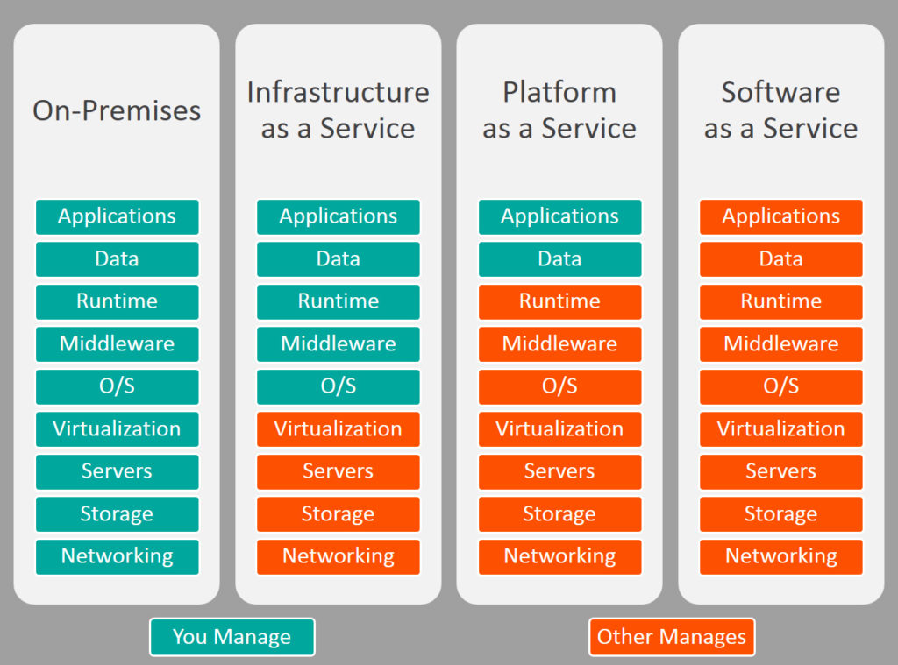
You Manage
You Manage
Others Manage

Slide 17
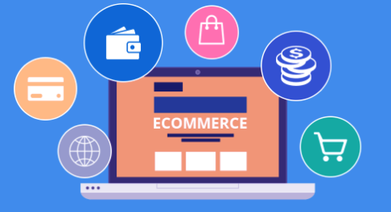
E-Commerce and Cloud:
Scalability
Reliability(Backups)
Improved mobility and enhanced accessibility
Cost reduction
Security
Speed

Slide 18
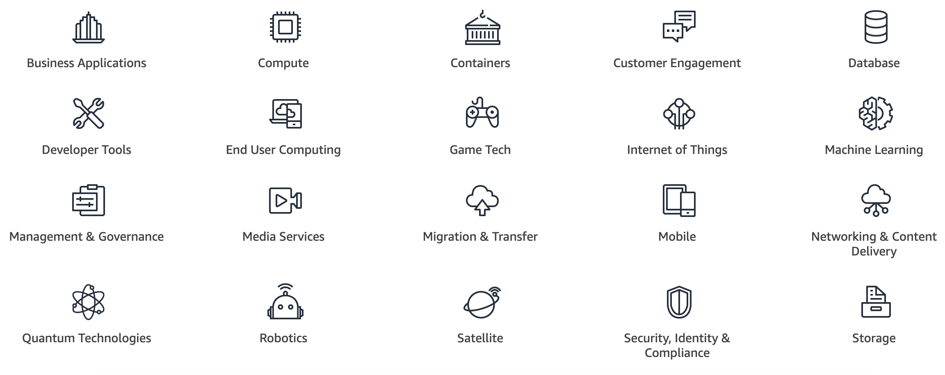
CLOUD SERVICES

Slide 19
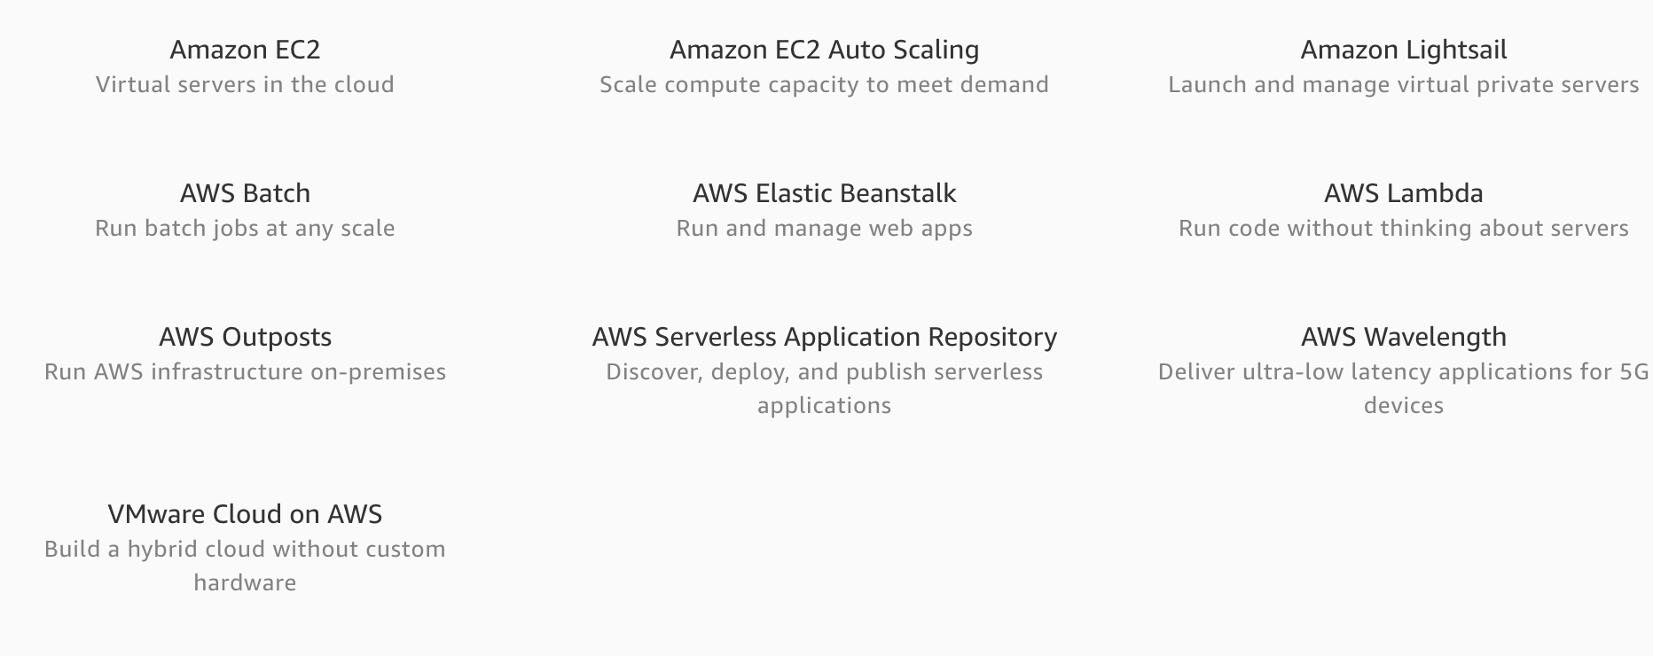
COMPUTE

Slide 20
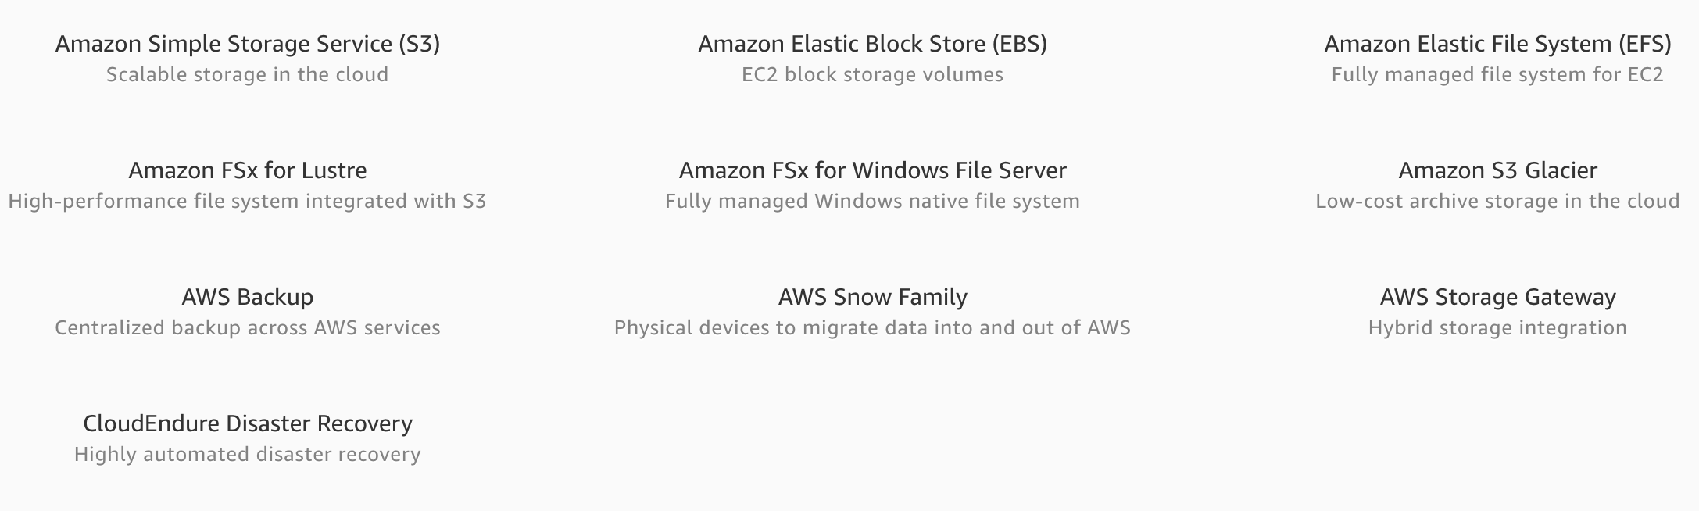
STORAGE

Slide 21
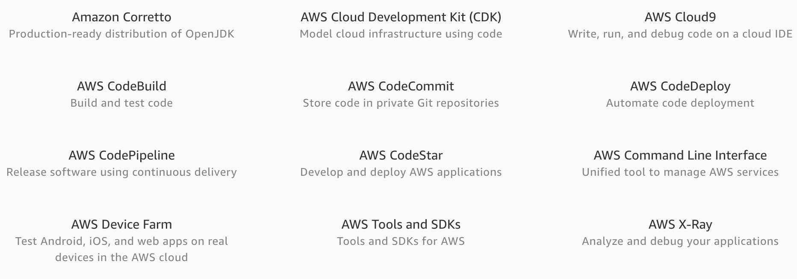
DEVELOPER TOOLS

Slide 22
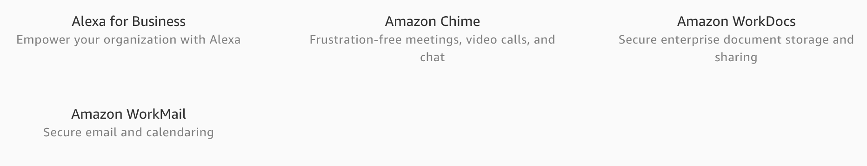
BUSINESS APPLICATION

Slide 23
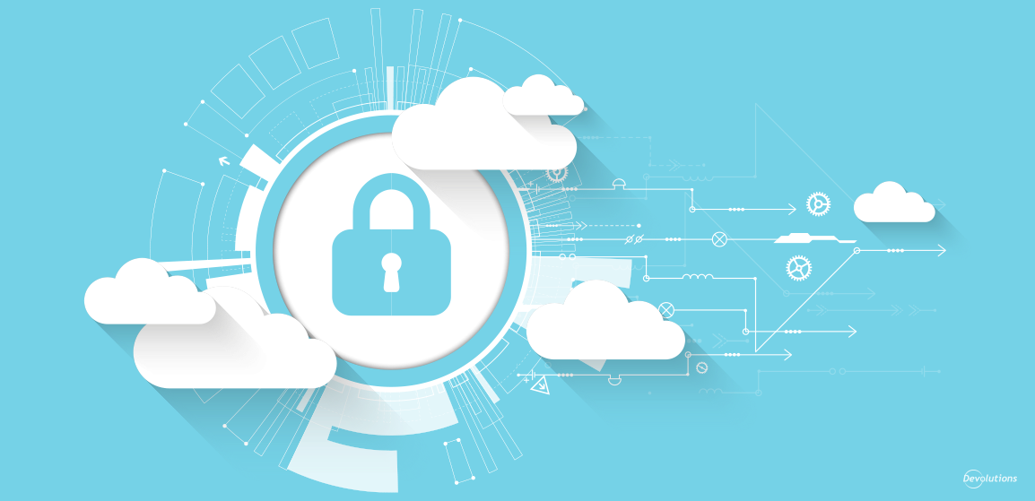
Cloud Security
What is Cloud Security?
Are public clouds Secure?
How secure should you make an application?
Troubleshooting threat in the cloud.
Cloud Security in AWS

Slide 24



Why Cloud Security?
Some of the disastrous Data Breaches….

Slide 25

What is Cloud Security?
It is the use of latest Technologies and techniques to protect your data, application and Infrastructure which is associated with Cloud Computing.

Slide 26
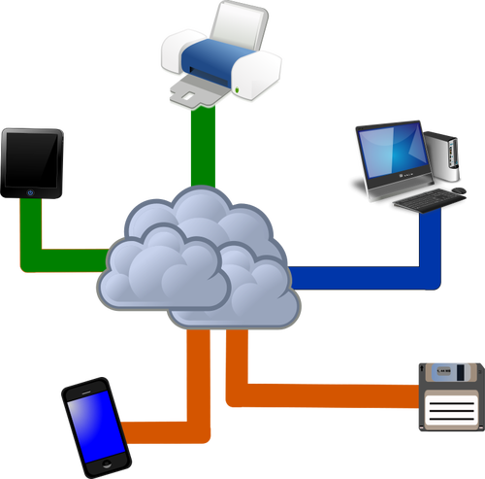

Are Public Clouds Secure?
Multi-tenancy
You Rent Computing Power(Storage space) → Cloud Provider → Alongside Other Tenants
It’s a lot like leasing a Physical space from a LandLord!
Cloud Control Matrix
Data Encryption
Hybrid Cloud

Slide 27


How secure should you make an Application?
Cloud Security is both SCIENCE and ART.
Come up with New ways of Securing an Application.
Create techniques in such a way that UX is not hindered.

Slide 28



How To Troubleshoot a threat in the Cloud?
Threat identification is done in 3 stages….
Monitoring Data
Gaining Visibility
Managing Access

Slide 29

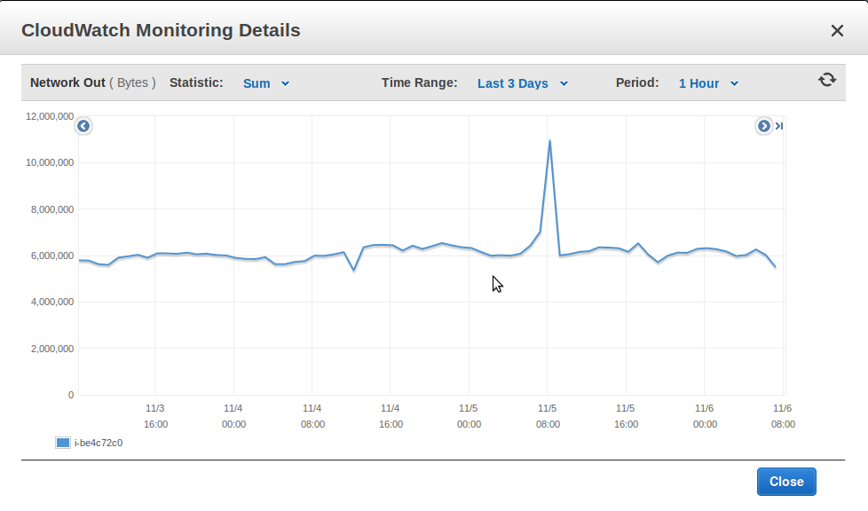
Cloud Security in AWS
1. Monitoring Data
There is a Cloud Monitoring Tool in AWS called AWS Cloud Watch where you can :
Monitor the data (Custom metrics)
Set Alarms
View graphs and Statistics
Monitor and react to resource changes.
Monitor Traffic

Slide 30
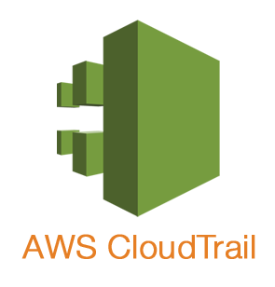
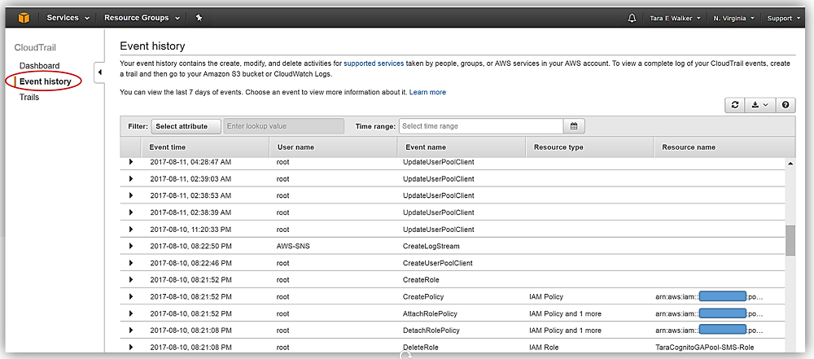
Cloud Security in AWS
2.Gaining Visibility
CloudTrail is a logging service which can be used
to log the history of API calls.
Every event that happens on the AWS console is
logged.
The tool where you identify the notorious Hacker.

Slide 31

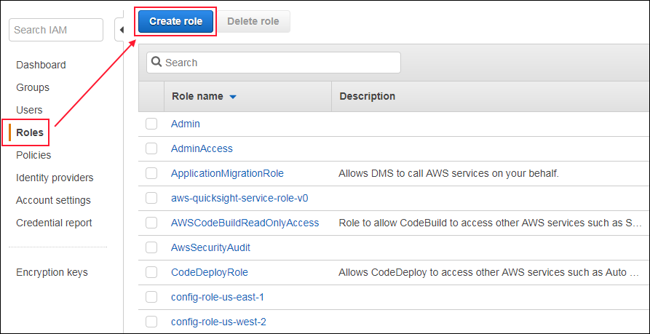
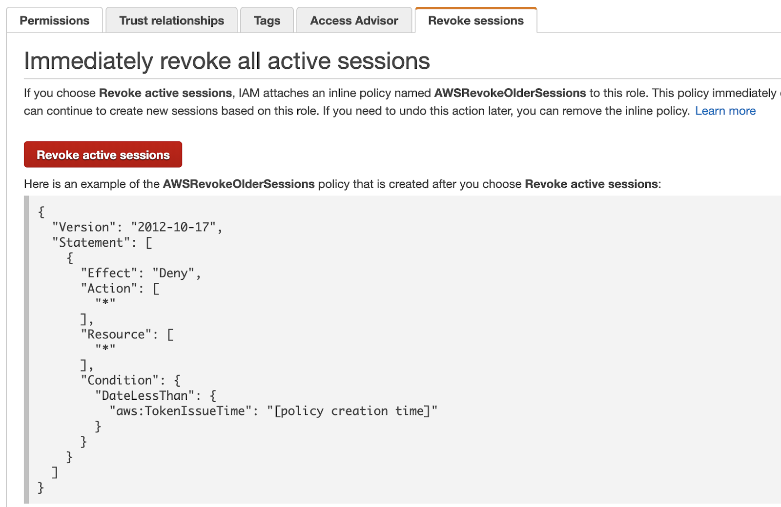
Cloud Security in AWS
3.Managing Access
Authenticates the Service
Used to provide Granular Permissions.

Slide 32
THANK YOU
Any Questions?

